Slide 1
Circuits!

Slide 2
ELECTRical & Computer Engineering
It all starts with the electron
Electrical current, charge, fields, magnetics, power, …
Electron?
Elementary particle, carries a negative charge
Holes?
The absence of an electron where one could exist
Will move from point A to B given a voltage

Slide 3
Electrons
Current
e⁻
e⁻
e⁻
e⁻
e⁻
e⁻
e⁻
e⁻
e⁻
e⁻
e⁻
e⁻
e⁻
e⁻
e⁻
e⁻
e⁻
e⁻
e⁻
e⁻
e⁻
e⁻
e⁻
e⁻
e⁻
e⁻
e⁻
e⁻
e⁻
e⁻
e⁻
e⁻
e⁻
e⁻
e⁻
e⁻
h⁺
h⁺
h⁺
h⁺
h⁺
h⁺
h⁺
h⁺
+
h⁺
h⁺
Voltage
-
e⁻
e⁻
e⁻
e⁻
e⁻
e⁻
e⁻
e⁻
e⁻
e⁻

Slide 4
ECE Fundamentals
Fundamentals of ECE:
Resistors (R), capacitors (C), inductors (L)
Battery, Voltage Supply, Ground
Current (I)
Flow of electric charge
Note: current is the movement from + to -
Voltage (V)
Electric potential between 2 points
i
+
v
Component
-

Slide 5
Simple Circuit
1 mA
+
5V
5 kΩ
-
Ohm’s Law: V = IR or I = V/R or R = V/I
I
V
I-V characteristic curve of a resistor

Slide 6
Water, Water Everywhere
Water makes a good analog for the world of electricity
Voltage (potential difference) → Water pressure
Current (flow of charge) → Flow of water
Wire → Pipe
Water examples from: “Electrical Engineering Uncovered,” D. White & R. Doering

Slide 7
Pipe Width
Given the same water pressure, which pipe’s water is moving faster
Water per second is proportional to area
Electrical is the same way, larger wires have less resistance, and higher current (given the same voltage)
Another analogy: traffic: more lanes = less resistance

Slide 8
Resistor
Ω
To build a resistor, vary length, material, and area to change the voltage/current characteristics
What if I put a sponge in the constricted part?
Given the amount of water passes through, which has the higher pressure?
The pressure (voltage is proportional to the resistance)
Voltage = Resistance * Current

Slide 9
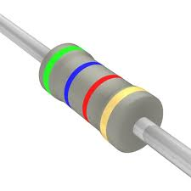
Electronic Color Codes
Resistors (and other components) have color bands to identify
First 2 bands are digits of the value, 3rd is the multiplier
Green-Blue-Red
5 6 10² = 5600 = 5.6 kOhms
Mnemonic
Black Brown Red Orange Yellow Green Blue Violet Grey White
Better Be Right Or Your Great Big Venture Goes Waa
- waa
0 1 2 3 4 5 6 7 8 9

Slide 10
Tolerance
The last stripe is tolerance
or variation
Electrical components come
with some variability
Resistors, capacitors, motors, transistors, etc…
5.6kOhm transistor with 10% variability
Possible range from 5.04kOhms to 6.16kOhm

Slide 11
Series/Parallel
In series, resistors see the same water flow (current), but different individual pressures (voltage)
In parallel, the resistors see the same pressures (voltage) at either end, but different current flow (current)

Slide 12
DC Voltage/Current Sources
Provide the energy to move the water
Motor/pump
Gravity (water tower)
-
+
-
+
+
-

Slide 13
Water Flow Potential
Potential

Slide 14
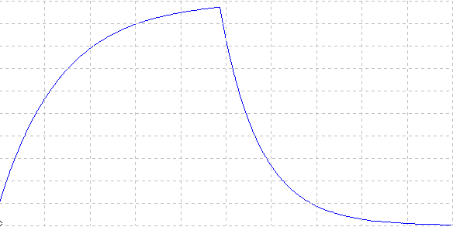
Capacitor
Water/electricity pushes the piston and pushes out water (no extra water passes the piston)
When the source disconnects, capacity is pushed out/unloaded
As springs coil, more energy needed to push them closed
When released, quick at first, then slows down

Slide 15
Capacitor Details
2 parallel plates separated by a dielectric material
Capacitance is a result of the dielectric material, the area of the plates, and the distance between the plates
C = εA/d
+ + + + + +
+ + + + + +
filled with dielectric
- -
- - -

Slide 16
Capacitance
Measured in Farads
Capacitance = Charge/Voltage
C = Q/V → Q = C*V → dQ/dt = C*dV/dt
Current through a capacitor = Capacitance * Change in voltage
i = C*dv/dt
Voltage across a capacitor cannot change instaneously

Slide 17
Water Flow (Capacitor)
Potential

Slide 18
Water Flow Time Lapse

Slide 19
Inductor
Current pumps in, gradually increasing, and once it gets going, takes time to stop
Releases its energy

Slide 20
Inductor Details
Wires wrapped/coiled around a core
As current passes through, magnetic charge is stored
When disconnected, it will push current and lose energy

Slide 21
Inductance
Measured in Henrys
Voltage across an inductor = Inductance * Change in current
v = L*di/dt
Current through and inductor cannot change instaneously

Slide 22
LC Oscillator
Once charged, will send the energy back and forth
If you monitor the movement at the top
Frequency (in radians) = 1/√(L*C)

Slide 23
C vs. L
Capacitor stores energy in an electric field
Inductor stores energy in magnetic field
Capacitor’s voltage cannot change instantaneously
Inductor’s current cannot change instantaneously
Capacitors become an open circuit at DC and short circuit at high frequency
Inductors become a short circuit at DC and an open circuit at high frequency

Slide 24
Diode
Diode allows current flow in 1 direction

Slide 25
BJT
Bipolar Junction Transistor
base
collector
collector
base
emitter
emitter

Slide 26
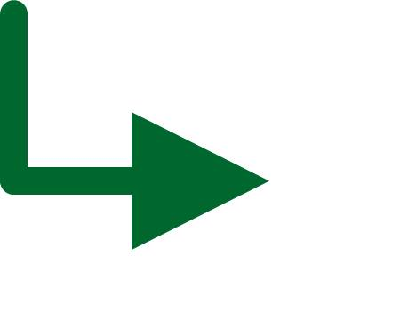
MOSFET
Source
PMOS vs. NMOS
For PMOS
if gate is ‘1’, no current flow
if gate is ‘0’, current flows
from source to drain
Source
Gate
Gate
Drain
Drain
Source
Source
Negative
pressure
Gate
Positive
pressure
Gate
Drain
Drain
For NMOS
if gate is ‘0’, no current flow
if gate is ‘1’, current flows
from source to drain

Slide 27
There are more analogies
Transformers, AC sources (low and high frequency), potentiometer,
Flow of water → flow of electrical charge (electrons/holes)
You will see plenty of electrical circuits
Kirchoff’s laws, Ohm’s law, mesh/node analysis

Slide 28
Summary of Electrical Quantities
Quantity | Unit | Important Equations
Charge (Q) | coulomb (C) | i = dq/dt
Current (I) | ampere (A)
Voltage (V) | volt (V)
Power (P) | watt (W) | P = dU/dt P = I*V
Energy (U) | joule (J) | U = Q*V
Resistance (R) | ohm (Ω) | V = IR P = V²/R = I²*R
Capacitance (C) | farad (F) | Q = CV U = ½*C*V² i = C*dv/dt
Inductance (L) | henry (H) | U = ½*L*I² v = L*di/dt

Slide 29
AC vs. DC
You’ve seen both
DC = battery, solar cell, fuel cell
No changes to current/voltage level
AC = turbine
Spinning rotor passes magnets to produce current
Current/voltage alternates between min and max in a sinusoid

Slide 30
Generator
Turn a loop of wire inside of a magnet
The change in magnetic field creates a current (thank you, Faraday)http://www.generatorguide.net/howgeneratorworks.html
I

Slide 31
Edison vs. Tesla
War of the Currents
Edison (DC) vs. Tesla/Westinghouse (AC)
Edison used to burn/electrocute cats saying that AC power was responsible
Called it being “Westinghoused”
Led to the first electric chair (by accident)
AC current is easier to distribute thanks to transformers (high voltage, low current)
http://theoatmeal.com/comics/tesla

Slide 32
Measurements
Aside from component values
Resistor (Ohm); Capacitor (Farad); Inductors (Henry);
Voltage: Amount of electric potential
Current: Charge per time
Energy: Amount of work to produce voltage/current in order to move the charge
Power: Amount of energy per unit time

Slide 33
With what to measure
Oscilloscope: Measures across time
Multimeter: Instant reading
Voltmeter/Ammeter

Slide 34
How to measure
To measure current:
Must be in the path
To measure voltage:
Must be outside the path
To measure power/energy:
Record the current/voltage/component characteristics
Do the math

Slide 35
Simple Circuit
1 mA
A
+
5V
5 kΩ
V
-
Ammeter – Measures current through a point
If you measure across a component, all the current will go around the component, changing circuit behavior
Voltmeter – Measures voltage across a component or many
If you measure voltage across no component, it has no resistance, which means there is no difference

Slide 36
Power and Energy
Power = I * V
= I * (IR) = I²R
= V/R * V = V²/R
Energy = Power * Time
Power and energy are often interchanged
Power is often how much heat is produced
Energy is how quickly your battery drains

Slide 37
Breadboard

Slide 38
CAD/Circuit Software

Slide 39
Soldering

